Slide 1
1
Smart Bluetooth glasses:
G05-C G05-H
G05-J G05-T3
December 10, 2023

Slide 2
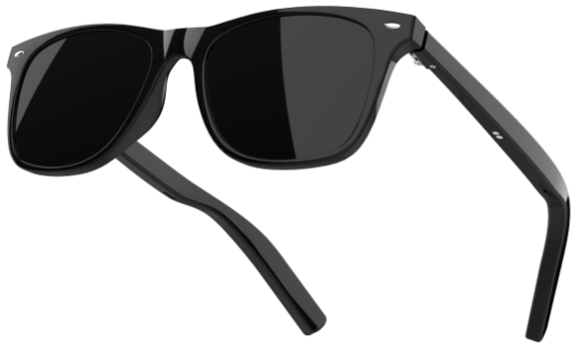
G05-C
Lens color: sunglasses/anti blue light lenses (can be paired with myopia lenses)
hardware feature |  | specific
 | Chip platform | Jerry 6973
 | Bluetooth 5.3 | Approximately 40 feet (over 12 meters)
 | Horn specifications | Lianchuang 1506 Three Magnets
 | Indicator light | Red+Blue (Left)+Red+Blue (Right)
 | Pure cobalt battery | 75mA+75mA
 | Charging | Magnetic charging sleeve 2-pin (left)+2-pin (right)
 | Charging time | About 70 minutes
 | Standby time | Approximately 158 hours
 | Call time | About 4 hours
 | Play music time | About 5 hours
Mechanical characteristics |  | specific
 | colour | black
 | control | Left+Right Touch
 | Mirror frame | PC
 | lens | TAC+UV400 (UV resistant)
 | Mirror legs | PC
 | waterproof | IP65
pack |  | specific
 | Smart glasses | 1pcs
 | Glasses case | 1pcs
 | Eyeglass cloth | 1 pcs
 | Data cable | 1pcs
 | Quick Guide | 1 pcs
 | Host weight | 33.3g
 | Single unit weight | 210.6g
 | Color box size | 200 * 80 * 70MM
 | Packaging size | 50.5 * 37.5 * 22.5CM (30 units/box)
 | Total weight | 7068g
Unit price: 95 yuan

Slide 3
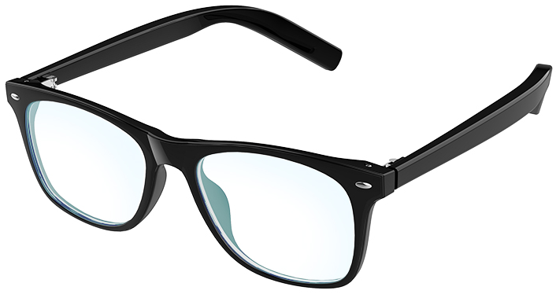
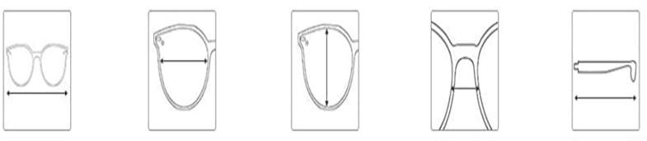
G05-C
145mm
54mm
43mm
23mm
155mm

Slide 4
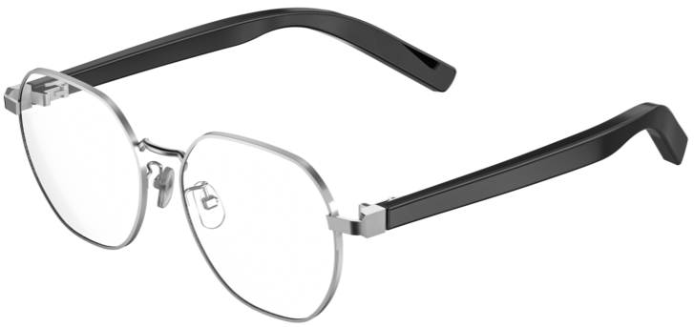
G05-H
Lens color: Anti blue light lenses (can be paired with myopia lenses)
hardware feature |  | specific
 | Chip platform | Jerry 6973
 | Bluetooth 5.3 | Approximately 40 feet (over 12 meters)
 | Horn specifications | Lianchuang 1506 Three Magnets
 | Indicator light | Red+Blue (Left)+Red+Blue (Right)
 | Pure cobalt battery | 75mA+75mA
 | Charging | Magnetic charging sleeve 2-pin (left)+2-pin (right)
 | Charging time | About 70 minutes
 | Standby time | Approximately 158 hours
 | Call time | About 4 hours
 | Play music time | About 5 hours
Mechanical characteristics |  | specific
 | colour | black
 | control | Left+Right Touch
 | Mirror frame | Light steel
 | lens | PC (anti blue light)
 | Mirror legs | PC
 | waterproof | IP65
pack |  | specific
 | Smart glasses | 1pcs
 | Glasses case | 1pcs
 | Eyeglass cloth | 1 pcs
 | Data cable | 1pcs
 | Quick Guide | 1 pcs
 | Host weight | 35.3g
 | Single unit weight | 212.6g
 | Color box size | 200 * 80 * 70MM
 | Packaging size | 50.5 * 37.5 * 22.5CM (30 units/box)
 | Total weight | 7128g
Unit price: 118 yuan

Slide 5
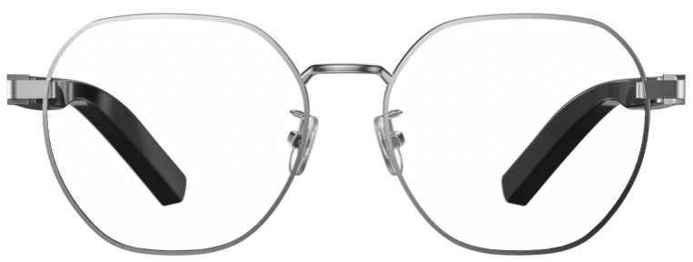
G05-H
141mm
55mm
50mm
20mm
155mm

Slide 6
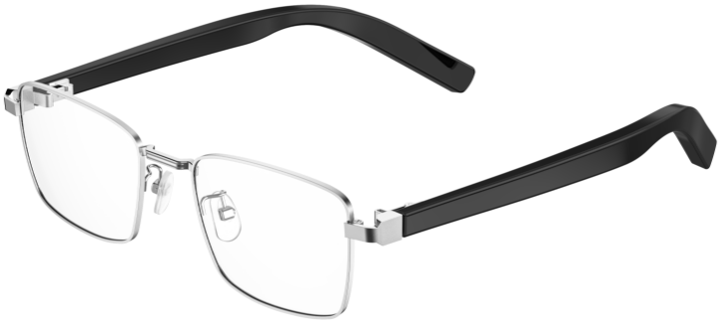
G05-J
Lens color: Anti blue light lenses (can be paired with myopia lenses)
hardware feature |  | specific
 | Chip platform | Jerry 6973
 | Bluetooth 5.3 | Approximately 40 feet (over 12 meters)
 | Horn specifications | Lianchuang 1506 Three Magnets
 | Indicator light | Red+Blue (Left)+Red+Blue (Right)
 | Pure cobalt battery | 75mA+75mA
 | Charging | Magnetic charging sleeve 2-pin (left)+2-pin (right)
 | Charging time | About 70 minutes
 | Standby time | Approximately 158 hours
 | Call time | About 4 hours
 | Play music time | About 5 hours
Mechanical characteristics |  | specific
 | colour | black
 | control | Left+Right Touch
 | Mirror frame | Light steel
 | lens | PC (anti blue light)
 | Mirror legs | PC
 | waterproof | IP65
pack |  | specific
 | Smart glasses | 1pcs
 | Glasses case | 1pcs
 | Eyeglass cloth | 1 pcs
 | Data cable | 1pcs
 | Quick Guide | 1 pcs
 | Host weight | 33.6g
 | Single unit weight | 211g
 | Color box size | 200 * 80 * 70MM
 | Packaging size | 50.5 * 37.5 * 22.5CM (30 units/box)
 | Total weight | 7080g
Unit price: 118 yuan

Slide 7
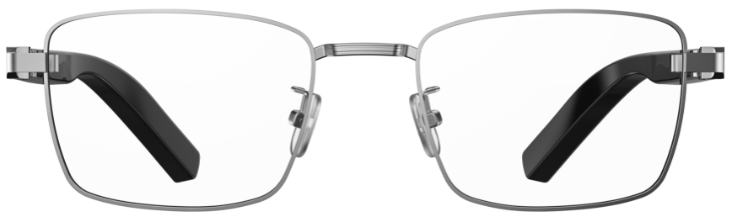
G05-J
143mm
53mm
39mm
23mm
155mm

Slide 8
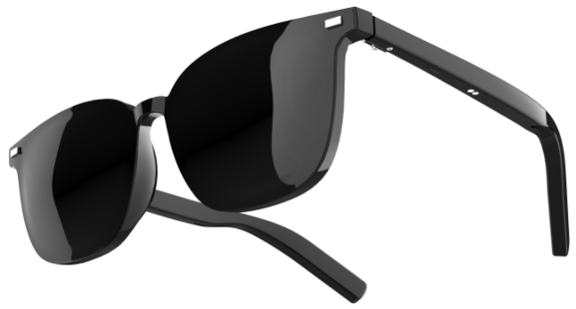
G05-T3
Lens color: sunglasses/night vision lenses/anti blue light lenses
(can be paired with myopia lenses)
hardware feature |  | specific
 | Chip platform | Jerry 6973
 | Bluetooth 5.3 | Approximately 40 feet (over 12 meters)
 | Horn specifications | Lianchuang 1506 Three Magnets
 | Indicator light | Red+Blue (Left)+Red+Blue (Right)
 | Pure cobalt battery | 75mA+75mA
 | Charging | Magnetic charging sleeve 2-pin (left)+2-pin (right)
 | Charging time | About 70 minutes
 | Standby time | Approximately 158 hours
 | Call time | About 4 hours
 | Play music time | About 5 hours
Mechanical characteristics |  | specific
 | colour | black
 | control | Left+Right Touch
 | Mirror frame | TR
 | lens | TAC+UV400 (UV resistant)
 | Mirror legs | PC
 | waterproof | IP65
pack |  | specific
 | Smart glasses | 1pcs
 | Glasses case | 1pcs
 | Eyeglass cloth | 1 pcs
 | Data cable | 1pcs
 | Quick Guide | 1 pcs
 | Host weight | 29.8g
 | Single unit weight | 217.7g
 | Color box size | 200 * 80 * 70MM
 | Packaging size | 50.5 * 37.5 * 22.5CM (30 units/box)
 | Total weight | 7281g
Unit price: 118 yuan

Slide 9
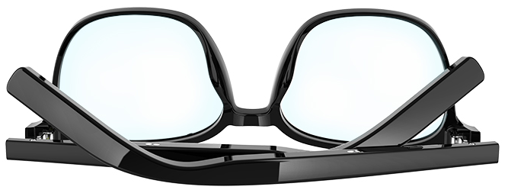
G05-T3
148mm
55mm
46mm
18mm
155mm

Slide 10
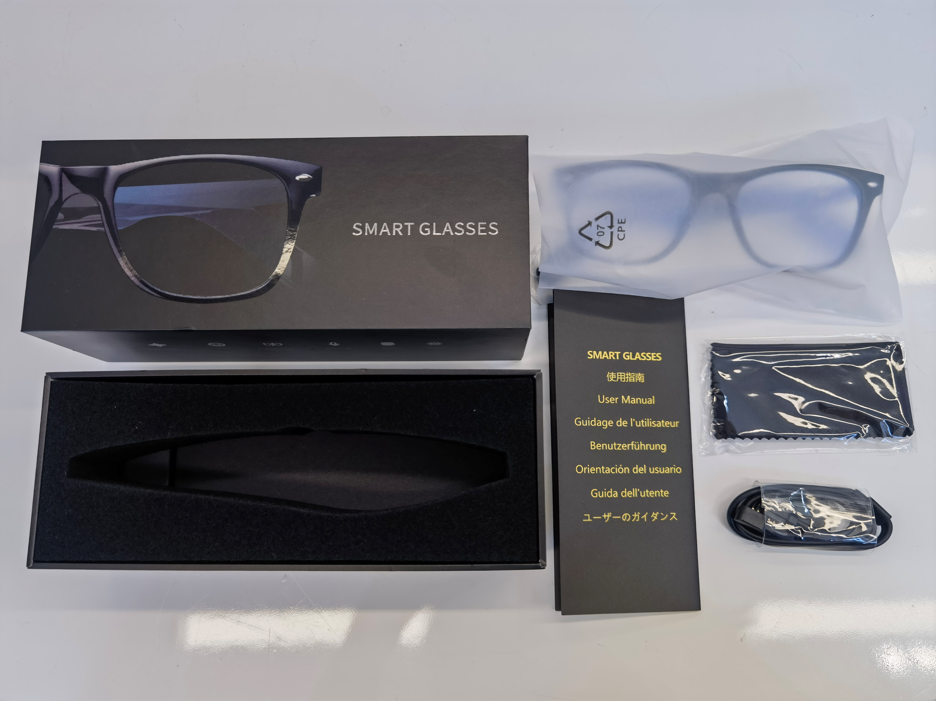
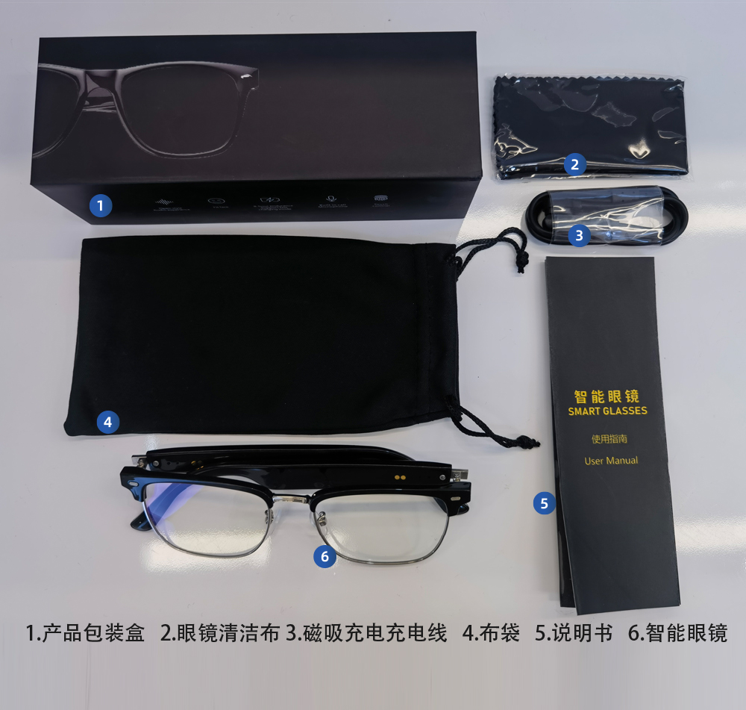
Packaging:

